Slide 1

Dreamscape AI
Senior Design 2024
SEMN

Slide 2
Our Team
Sara Marijolovic
Eli Detmers
Michael Pappa
Nick Murray
Project Advisor:
Dr. Will Hawkins

Slide 3
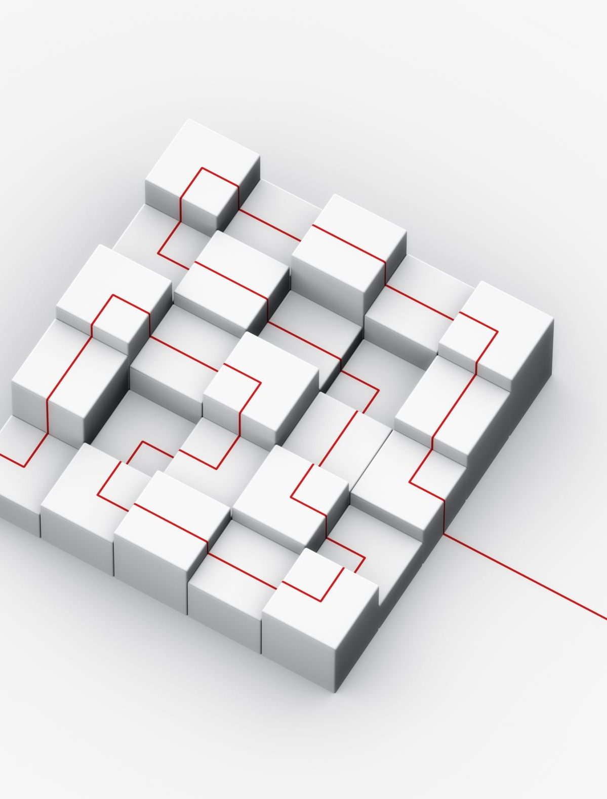
Goals
Using AI image generation to create custom images based on prompts users give as input to the application.
Custom pictures can be uploaded to our application and the user will apply tags to the uploaded images.
Our AI data model will be able to use the images, tags, and prompts to generate images.
After the images are generated, they can be exported to the user's device and used at their discretion.

Slide 4
Intellectual Merits
While other AI image generators exist, none allow the user to upload their images into a new object that can immediately be used in their prompts.

Slide 5
Broader Impacts
A college student who wants to decorate their dorm with personalized wallpapers that they can make in our AI application, so that they can make their room look more vibrant.
People who want to give our personal gifts to friends or relatives with pictures of them together to show their closeness.
A widowed person who wants to recreate a memory of themselves and their loved one through AI imaging so that their memory can live on.

Slide 6
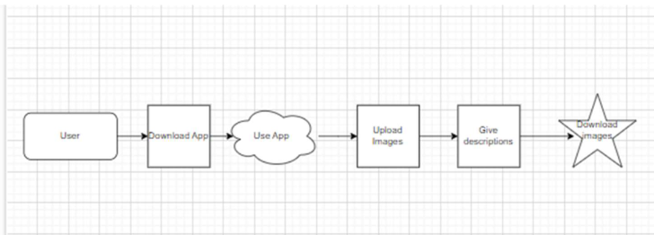
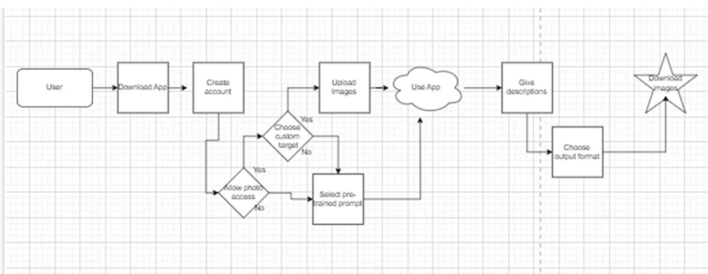
Design Specifications
Simplified Diagram
We have built a React based UI development environment
The backend of our app includes running multiple API calls to and from the AI model. One call to build the model with the imported pictures and one that will generate the desired image.
Advanced Diagram

Slide 7
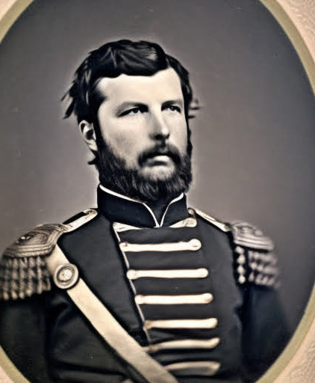
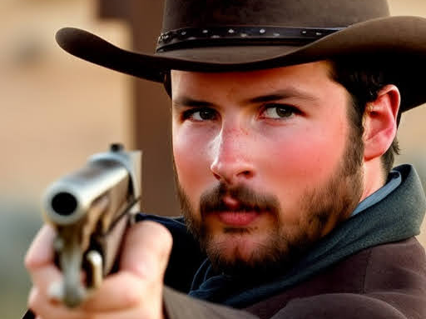
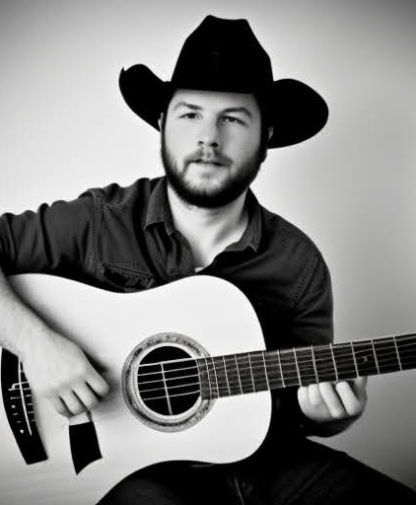
Technologies
Use of LoRA Stable Diffusion Model
Replicate processing and API calling
UI made in React and hosted publicly
Python backend

Slide 8
Milestones
3 Oct. 24
User interface complete
19 Mar. 24
AI model has been implemented with interface
24 Mar. 24
Testing complete
27 Mar. 24
Final fixes and retests complete
4 Sep. 24
Present at Expo

Slide 9
Results
We have completed our research on the AI model we are using (Stable Diffusion).
We have determined a way to use APIs to use the model with our interface.
We have decided on requirements for our interface and have an initial design.
We have developed a test plan to keep us within the requirements of the project.

Slide 10
Challenges
Connection from UI to model training was not possible with previous framework, official API connection was not supported
Found Replicate service that has easy API integration to our UI
Time took to train model was egregiously long
Switching to a LoRA has decreased the time to around 8 minutes

